Slide 1

Digital Portfolio
HCI430: A4 - Narrative Digital Prototype (Group 8)
Anh Nguyen
Eshani Somwanshi
Parisa Arbab
Vishal Reddy Gundepally

Slide 2

Digital Portfolio App
The digital portfolio app is an online platform for hosting and sharing portfolios. It allows users to upload their work, connect with peers in related fields, and serves as a centralized hub for showcasing candidate portfolios. It offers an efficient way for potential clients to review candidates' work and initiate contact if interested. Additionally, it provides tools for job seekers to customize their portfolios, helping them differentiate themselves. The app is accessible on tablets, phones, and desktops, ensuring a broad user base.

Slide 3
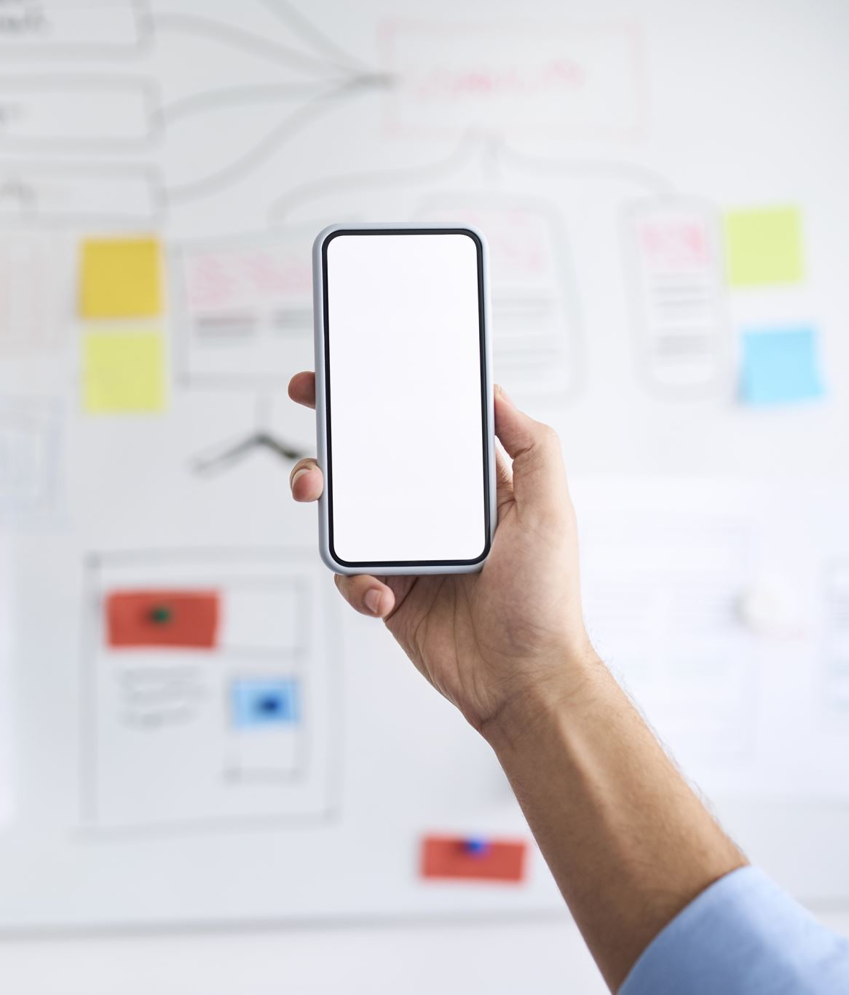
Application purposes
Offers an easy-to-use platform to display a user's body of works
Customizable profile layouts to help users stand out from the crowd.
Get to know your target industry.
Cater to users from a variety of industries.
Connect with like-minded creatives.
Display things cleanly and professionally!
A feeling of pride in showcasing a user's portfolio.

Slide 4

Monetization
The application will be monetized through featuring some relevant ads and a membership service. The membership service will offer better search results for candidates who subscribe, more profile customizations, and no ads appearing on their profile.

Slide 5
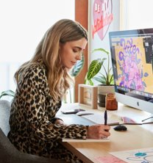
Key User and Profiles
Maya – successful freelance illustrator
Very Tech savvy.
Variable income due to freelance work.
Uses the latest iPhone, iPad, MacBook, and iMacs to do her work.
Wants to expand her network of clients and colleagues and elevate her online presence as a professional illustrator.
Sarah - A high – achieving college student
Somewhat tech savvy.
Minimum wage income.
Frequently uses refurbished MacBook and iPhone she carries around for both school and commission work.
Wants to network and expand her online presence as an aspiring creative to land a job in the creative field.

Slide 6
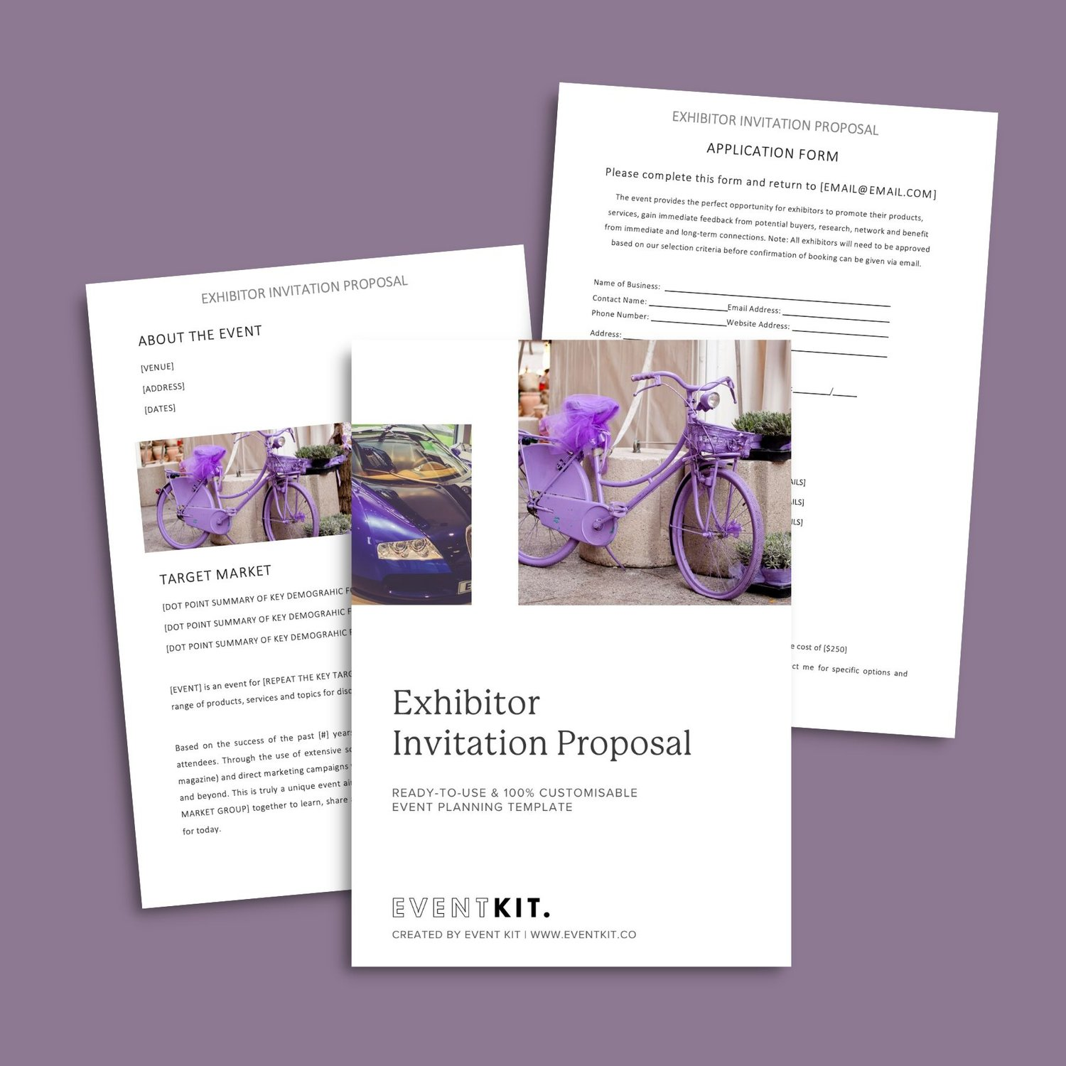
Scenario: The Art Showcase Event
Meet Maya, a freelance illustrator who has been using the portfolio app to showcase her work. She's been diligent about updating her portfolio with her latest creations, and she regularly shares her portfolio links on her social media profiles.
One day, Maya receives an invitation to take part in a prestigious local art showcase event. Excited about the opportunity, she accepts the invitation. As the event date approaches, she decides to revisit her portfolio on the app and….

Slide 7
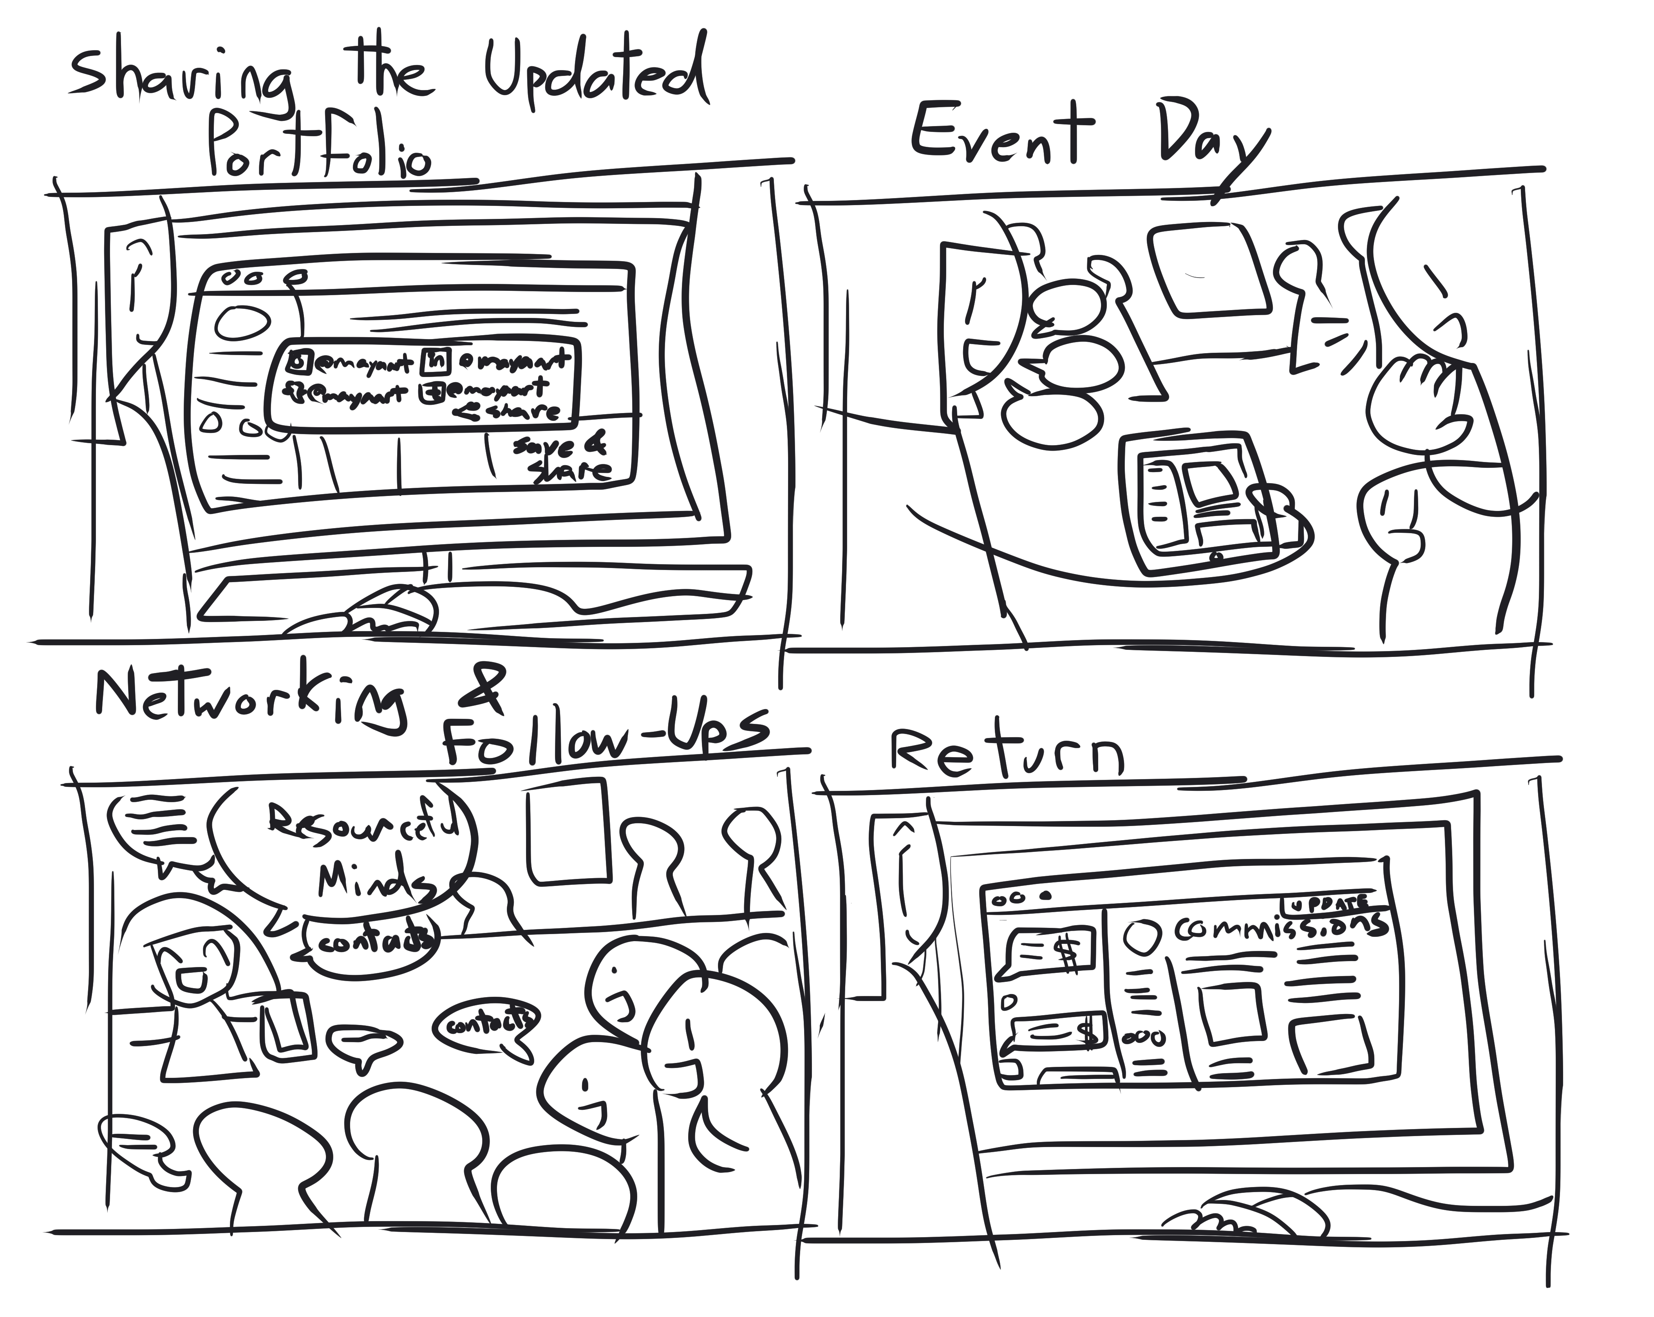
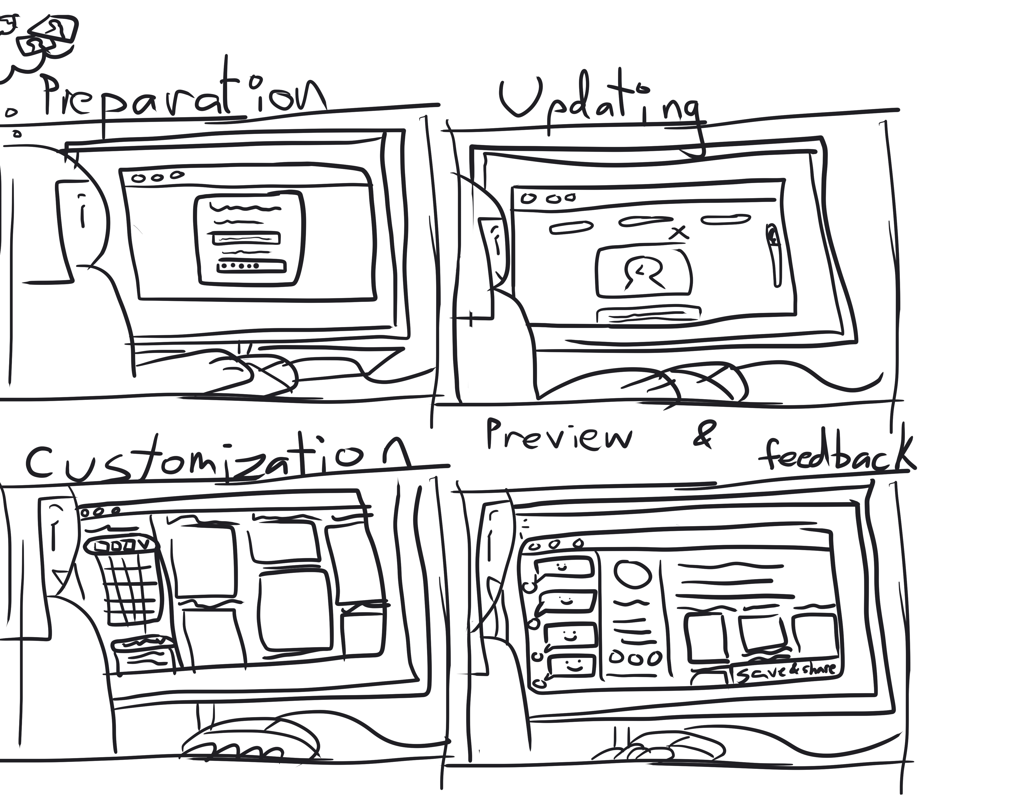
Storyboard

Slide 8
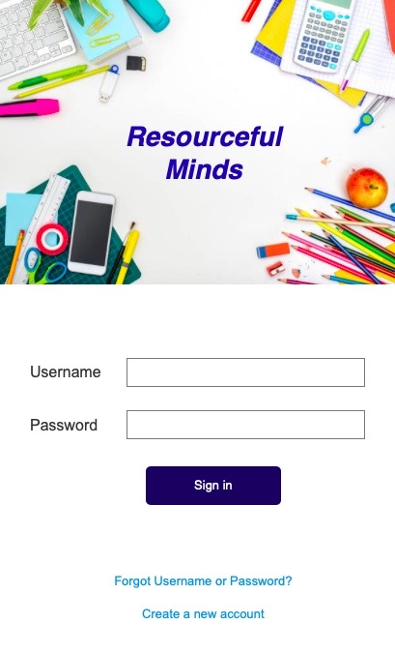
Scenario: Preparation
Maya logs into the portfolio app on her desktop computer. She knows that the event will feature a diverse group of artists, including painters, sculptors, and photographers. She wants her portfolio to stand out and make a lasting impression on the attendees.

Slide 9
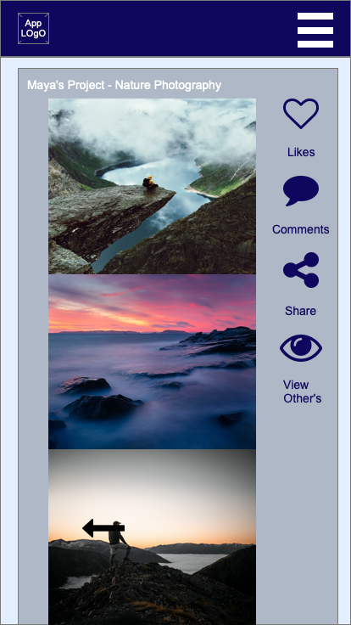
Scenario: Update Portfolio
Using the app's easy-to-use interface, Maya begins updating her portfolio. She uploads high-resolution images of her latest illustrations and arranges them in a visually appealing order. She also adds a brief description of her creative process and the inspiration behind each piece.​

Slide 10
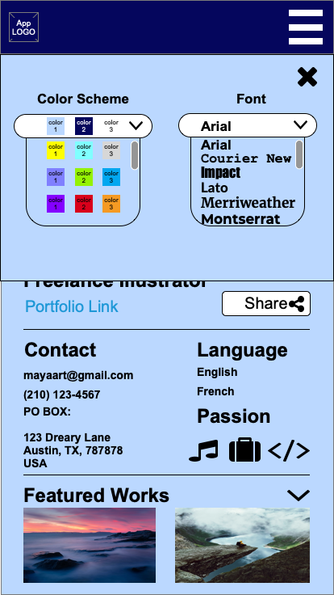
Scenario: Customization
The app allows Maya to customize the color scheme and fonts to match her unique artistic style. She selects a palette that complements her artwork and chooses a typography style that gives her portfolio a professional yet artistic touch.

Slide 11
Scenario: Sharing
Maya clicks the "Share" button and posts her updated portfolio link on her social media profiles, letting her followers know that they can view her latest work before the art showcase event.

Slide 12
Scenario: Preview & Feedback
Before completing her changes, Maya previews her portfolio to ensure everything looks perfect. She notices a few friends and fellow artists have already left encouraging comments on her work within the app. Their feedback boosts her confidence

Slide 13
Scenario: Event Day
On the day of the event, Maya arrives with her tablet, ready to showcase her portfolio to attendees. As visitors approach her booth, she uses the mobile version of the app to guide them through her portfolio, supplying insights and stories behind her artwork.

Slide 14
The End

